Slide 1

DriverPass System Analysis
Winnie Kwong
Notes:
[No speaker notes required for this slide.]

Slide 2

System Requirements
Functional requirements
The system shall provide training such as online classes and practice tests, as well as on-the-road training.
The system shall show the status such as not taken, in progress, failed, or passed of tests and work of the user.
Nonfunctional requirements
The website attendance limit must be scalable enough to support users without any crashes or performance deterioration
The system should be able to run on Mac, Linux, Windows, and mobile devices such as Android and IOS
Notes:
Functional requirements define the features and functions and that implemented for users to accomplish their tasks. The DriverPass’s system must be available to access anytime at any place to ensure customers are prepared to take the driving test. Offering a feature that shows their progression of lesson plans and practice tests can provide visual feedback of their advancement to their goals. Customers will also be more organized and focused to determine on areas that need improvement.
Nonfunctional requirements define how the system should perform. Having a website that can scale enough to support users without crashing is essential because it means the website cannot transmit or receive data. If the website is unreachable, it make lead to negative effects on the business reputation. Also, the importance of running through multiplatform operation enables the range of audience to increase for business. This means DriverPass would be able to attract different demographics to ensure DriverPass’s goals are achieved.

Slide 3
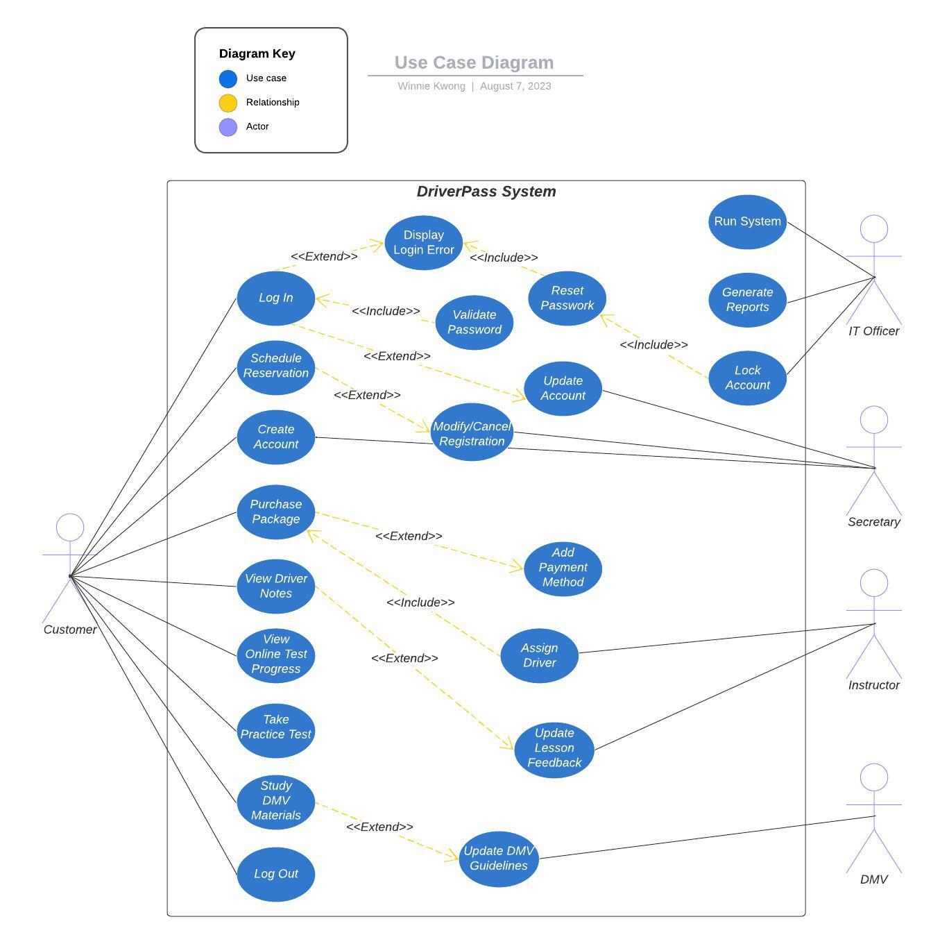
Use Case Diagram
Notes:
The customer will be responsible for using the front end of the system. Once customers access the DriverPass homepage, they will be prompted to log in or create a new account before accessing a dashboard. If the customer has any issues with validating their password, there will be a pop-up displaying an invalid password error. After a few attempts, the customer’s account will be locked, requiring the IT officer to provide a reset link to unlock the account. Once the customers have logged into the account, they will have access to purchasing packages, updating their account information, reviewing instructor feedback, viewing online test progress, taking exams, and studying the official guidelines of DMV Materials.
The IT officer, Secretary, Instructors, and DMV will manage all the back-end functions of the system. The IT office will maintain the entire system while generating reports of the system’s database. The Secretary will help with all registration inquiries that apply, modify, and cancel. The Instructor will be assigned to the customer depending on which package is purchased from the website and will provide detailed feedback on any errors the student may have during the lesson plan. Lastly, the DMV will give all updated guidelines to ensure customers have to correct information to pass the driving test.
The diagram was created to fulfill and consider all DriverPass’s needs. The system will provide learning materials for DriverPass to enable customers to pass the driving test more often. Customers can set appointments for their lesson plans with and without employees assisting throughout the process if needed. Customers will also have the resources to review DMV guidelines, review lesson feedback, and view their progress. The IT officer will be able to generate reports to ensure the system efficiently reaches the DriverPass’s vision.

Slide 4
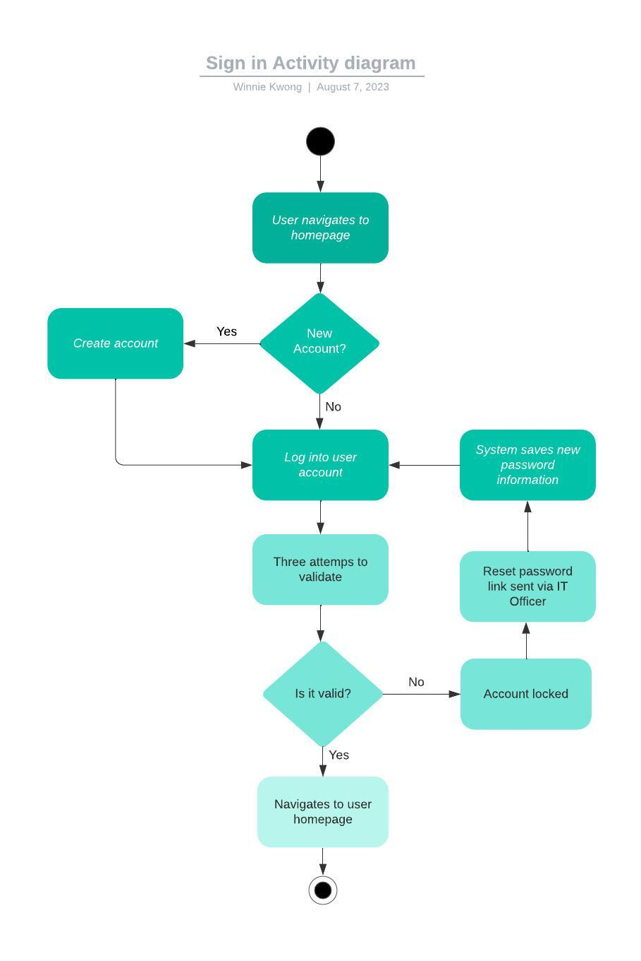
Activity Diagram
Notes:
The activity diagram presented is the step-by-step activity of a user that will sign into DriverPass's website. The initial stage is when the user opens their browser via computer or cell phone. DriverPass will accept all operating platforms, such as Windows, Linux, Mac, Android, and iOS. From there, the user can either create a new account or log into their account directly. If the user submits the incorrect password after three attempts, the account will be locked, and they will need to reset their password to complete the activity to access the dashboard homepage. The DriverPass's needs were implemented into the design upon the request from the owner to allow the IT officer to have full access over all accounts to reset the password. The IT officer will also ensure the account was not a victim of a malicious attack by asking security questions included during the registration process. Another fulfilled need was to enable DriverPass to be accessed via multiple operating platforms to expand the range of audiences to access the website.

Slide 5
Security
Passwords will require to be case-sensitive and request for the length to be at least a combination of 8 letters, digits, and symbols.
Accounts should also include two factor authentication to include an extra layer of protection to ensure the security of user accounts.
Cloud servers will include encryption to restrict unauthorized users from obtaining personal information.
In the events of a “brute force” hacking attempt to an account, the user will receive an email or text notification and have their account locked. Users will need to contact support to unlock the account.
If users forget their password, a one-time password will be sent to the user through text or email then will be sent a link to reset their password.
Notes:
Security is essential for DriverPass because it ensures rules and regulations are followed. Offering a stronger password and an extra layer of authentication and encryption allows customers to feel safer knowing their private information is protected from unauthorized users like hackers. If the customer’s account is breached, there will be an instant notification that the account is being used on an authorized device. The system would request confirmation from the user first before the account is locked to protect sensitive data. Unfortunately, forgetting one’s password is a frequent situation that occurs. Luckily, DriverPass implemented a one-time password to help users access their information to retrieve a link for resetting their password. Driverpass wants to ensure its customers feel safe and will offer the necessary steps to protect them.

Slide 6
System Limitations
Users will have a dependency on internet connectivity and electricity.
Users must have a technical and programming knowledge background.
The client has not provided a set budget for the project.
Project must be completed to client’s expectations within five months.
DMV guidelines can constantly change, and the system must revolve around it to be consistent.
Users will not have access to the system if the sever connection to electricity is lost.
Notes:
In every organization, there are always limitations to what a system can or cannot execute. Users must rely on internet connectivity and electricity to turn on their devices and access the web browser. It is optional to be tech-savvy, but a user should understand the basic knowledge to navigate the website efficiently, such as learning the tools offered within the websites. The client still needs to provide a budget limit with the system's backend but requested project completion within five months. With knowledge of the budget, it is easier to determine what resources can be offered to the website and how to distribute the funding properly. Also, the DMV guidelines can change at any moment, and the system must be consistent with the DMV guidelines. If the system is not in sync with the DMV, DriverPass would unknowingly provide customers with wrong information, which may lead to a bad reputation and unsatisfied customers failing their driving test. Lastly, DriverPass must ensure ways to protect its server from losing electricity. If the power is out, the website will become inaccessible and unable to perform user tasks. If the website is down, there will be less traffic and potentially lose customers.

